Slide 1
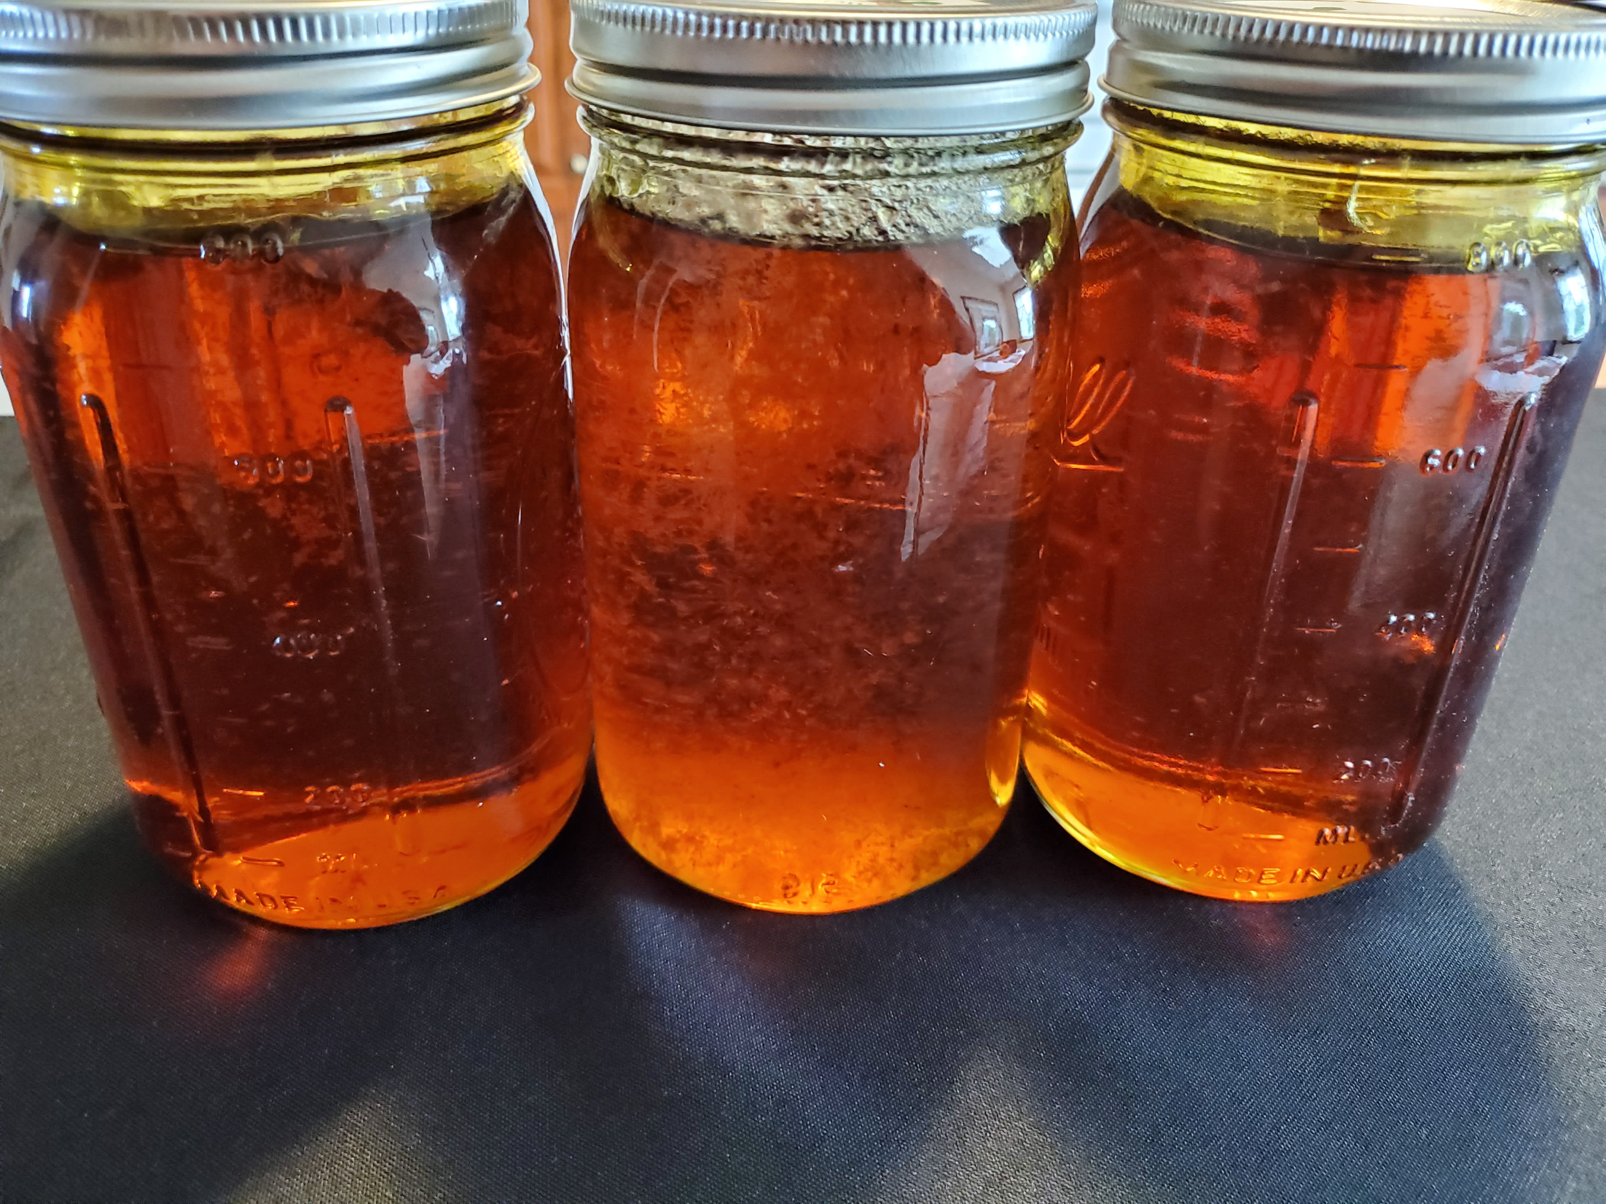
Profiting From Cannabis Sativa
This Document is a Training Manual for the Industrial Marketing & Sales of Hemp Plant Extracts, these include: Broad Spectrum Cannabidiol (CBD) with 0.0% THC, Full Spectrum CBD, and Isolates for CBD, CBG, CBN, CBDa etc.
>90% CBD Extract w/0.00% THC
(non-detectable)

Slide 2
Contents
SECTION I Introduction
About This Manual ……………………………………………………………………………................. 3
Overview Of Industry ……………………………………………….............................................. 4
SECTION II CBD Industry
CBD Industry Organization……………………………………….............................................. 5
CBD Retail Snapshot ……………………………………………………………………………………….. 6
CBD Distribution ………………………………………………………………………………………......... 7
SECTION III Products
Product Line-Up ………………………………………………………………………………….…........... 8
Product (SKUs) Descriptions …………………………………………………………………............ 9
Certificate of Analysis (COA) ……………………………………………………………...….………. 10
SECTION IV Finished Goods
CBD Consumer Products …………………………………………………………………………........ 11
CBD Consumer Packaging …………………………………………………………………………….. 12
SECTION V Hemp & CBD Technology
Hemp Plant Overview ………………………………………………………………………………........ 13
Hemp Oil Extraction Methods …………………………………………………………………......... 14
Hemp Neuro-Science ……………………………………………………………………………........… 15
Hemp Plant Cannabinoids ………………………………………………………………………......... 16
SECTION VI LEGAL
Federal CBD Program Status ……………………………………………………………………........ 17
State CBD Program Status ………………………………………………………………………......... 18
Licensing & Certifications …………………………………………………………………………........ 19
SECTION VI SALES & MARKETING
Sales Presentation …………………………………………………………………………………………… 21
Price List ………………………………………………………………………………………………………….. 23
Glossary ………………………………………………………………………………………….…………… 24
Page
CLICK ON UNDERLINED TITLES TO GO TO PAGE
TO RETURN TO CONTENTS CLICK ON LOGO SWIRL
2
© 2020 HyperNovaTN, LLC

Slide 3
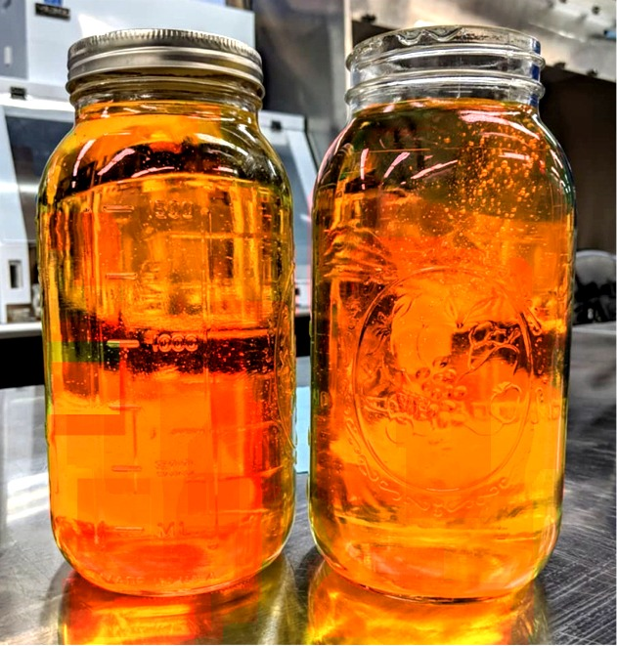
Introduction
About This Manual
Format
We have written this manual to inform you about CBD and the markets it serves.
Almost everything you need to know is contained in these pages and culled from
many sources. The idea is you should only need this document to come up to speed
quickly and begin the process of marketing our CBD products: the extracts from the hemp plant that brand-name manufacturers of CBD consumer packaged goods need to fulfill their specialty CBD-based products.
Presentation
On page 21 we provide a sample presentation outlining of what we believe will work best when meeting new prospects. We show hints in this text as to why you should emphasize certain ideas. We are not “sales experts,” but we have learned from many years of experience the best way of bringing on a “recurring revenue” customer. Keep in mind CBD extracts are NOT created equal, but by the same token OEM customers expect the very best as the extract you are selling is paramount to their newly CBD infused products – and it’s a medicine they are using, so it gets personal with their consumers who expect nothing but the very best – and consistently!
Caution!
The hemp industry in the United States is now just one year old, so it’s wise to keep in mind many prospects will have no idea, or be mistaken about CBD. Others will think they know everything! So you must be on guard to carefully nurse the uninformed and not try to compete with the wiser ones – chances are some will be, and alienating them will hurt your chances of furthering a relationship. CBD extract sales is a consultative type of selling, meaning the information you impart are the benefits and features, and acting “salesy“ will certainly diminish chances of success. However, as a professional you well know when it’s the right moment and day to ask for an order – and when to not!
>90% CBD Extract w/0.00% THC (non-detectable)
3
© 2020 HyperNovaTN, LLC

Slide 4
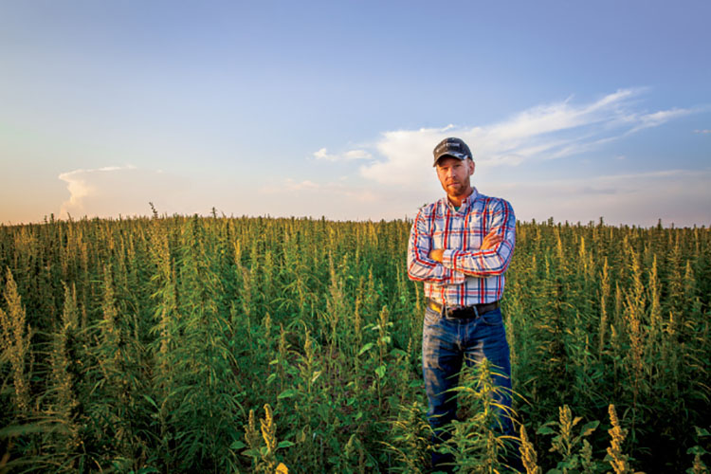
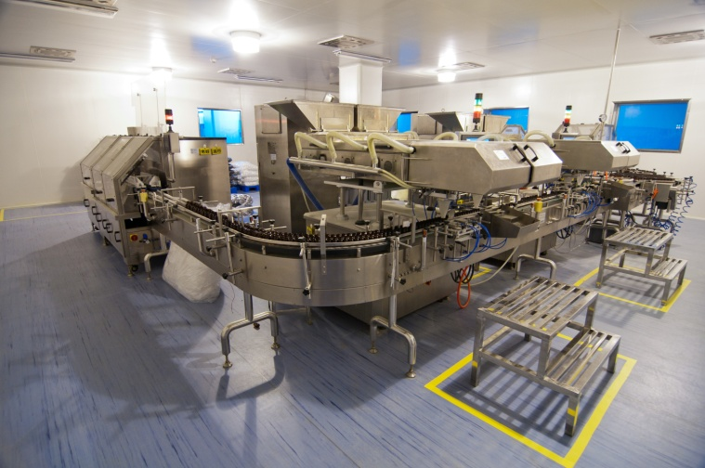
Overview
Summary Marketing Plan
The Primary Focus
The Company is exclusively involved in the extraction and further processing of the compounds from the hemp plant; and to be infused by others in a plethora of consumer packaged goods, and sold nationwide in stores and on-line by mass market retailers. The Company will offer its extraction services to:
1. Farmers/cultivators of hemp who do not have extraction capabilities. In the U.S. there are currently about 25,000 farmers managing 78,000 acres of hemp. Leading states are: Colorado, Oregon, Kentucky, Vermont and North Carolina. Catching up fast are: California, New York , Montana, Tennessee, Alabama and New Jersey.
2. Small CBD product developers/manufacturers These are small companies with as few as 5 or so employees where some have bought very basic extraction equipment and operate out of their homes or small commercial spaces. They typically get their start with a quasi-franchiser who hand-hold them from buying the hemp or extracted oil to installing equip- ment and then bringing their products to market. Many do not do extraction and therefore are an opportunity for the Company.
3. Original Equipment Manufacturers (OEMs) who infuse hemp oil into a plethora of products from tinctures to balms, cosmetics and shampoos to candies, cookies, beverages and pet foods . . . and hundreds of other CBD consumer packaged goods.
4
© 2020 HyperNova, Inc.

Slide 5
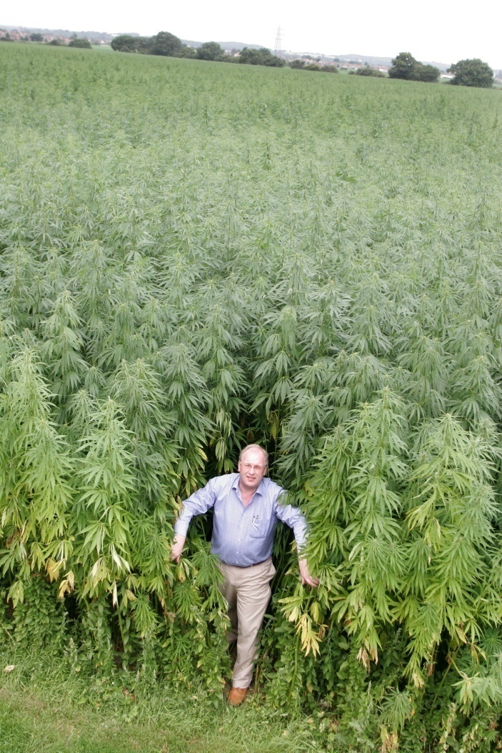
CBD Industry Organization
The Operations Chart Below Provides a Snapshot of How HyperNovaCBD Interfaces With Various Elements of the Hemp Industry
Biomass & Chemicals
Farmers
Extraction Process
Extractors
Sales & Marketing to OEMS
3rd Party Testing
Product Development
Mass Market Distribution
Critical hemp
vetting
Supplemental
Product when needed
With others
Retail and On-line
Farmer inspecting his crop. Not all Hemp is created equal and why testing occurs at least three to five times before infusing its oil or in powder form into consumer products.
5
© 2020 HyperNovaTN, LLC

Slide 6
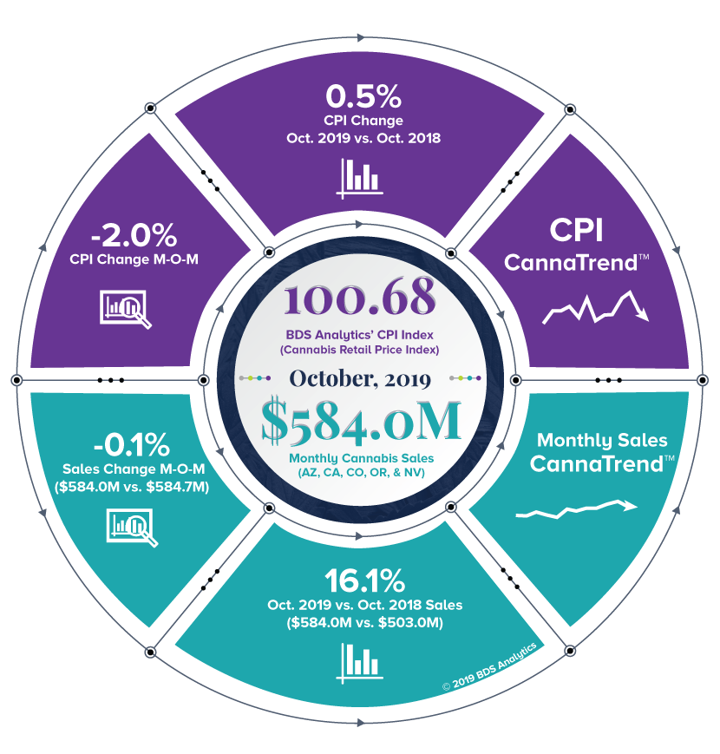
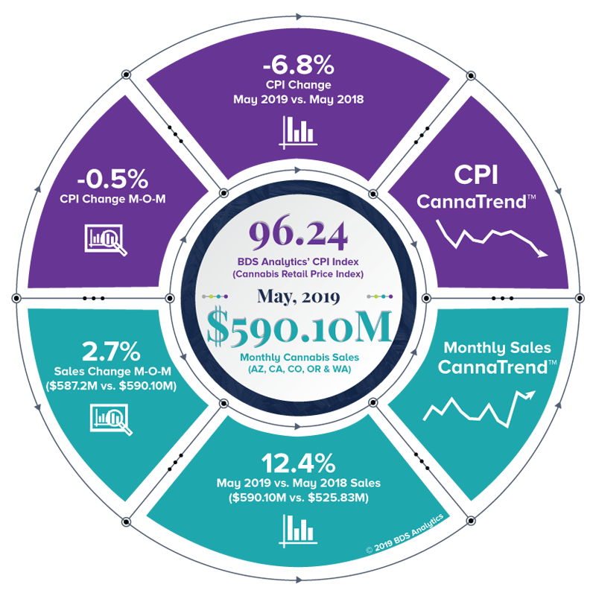
Retail CBD Snapshot
Extrapolating Western Region U.S. Totals to All 50 States* (from Charts)
Change In Key Metrics for CBD Retail 5/19 vs 10/19
For AZ, CA, CO, OR & NV (Total Population, 57M)
Assuming western market gross sales currently represent 17.2% of U.S. population as per survey of the 5 states w/57M pops; then entire market of 57M should deliver a total gross per month of $584M/57M pops = $10.24 /pop revenue. So, for the entire U.S.: 332M pops x $10.24/pop = $3.4B gross sales per year. (Assumes all states have CBD programs). If THC free CBD remains at 18% of total CBD extract used to manufacture CBD products, then the total gross revenue from THC free CBD = $126M/year.
CBD extract used =16,686 Kg/mo x 12 mths @ $2,500/Kg = $500.4M/year*
*
All products contain CBD oil. Avg. amount of CBD per unit sold = 1g. Avg. retail price $35 per unit = total volume of $584M /$35= 16.7M units sold/month. At 1g CBD/ unit sale = 16.7K Kg of CBD extract used, x avg. price from Extractor of $2,500/Kg = $41.7M/mo. = $500.4M/year. If 18% of US market THC free @ 3,003 Kg x $3,500/Kg = $10.51M x 12 months = $126M/year.
(Above) Two distillations columns:: one for methanol removal the other for final biodiesel distillation
6
© 2020 HyperNovaTN, LLC

Slide 7
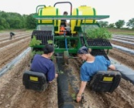
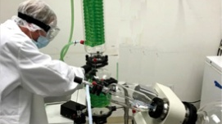
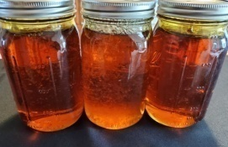
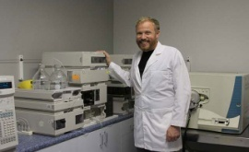
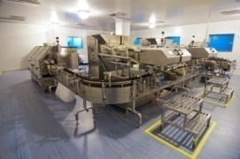
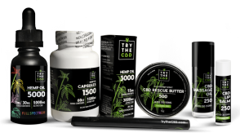
CBD Industry Distribution
Top 10 CBD Facts and Statistics
The sales of CBD are predicted to reach over $2 billion by end of 2021
Cannabis researchers BDS Analytics and Arcview Market Research, projects that the collective market for CBD sales in the U.S. will surpass $10 billion by 2024
At the moment, there are about 850 brands of CBD products in the US market.
Colorado is the state with the highest hemp revenues.
BDS Analytics predicts that the majority of CBD product sales will soon occur in general retail stores instead of on-line.
Data on CBD users show 40% of Americans interested in CBD.
A cannabis worker earns more than an average American.
The demand for employees in the CBD oil industry rose by 76% within the last year.
Statistics on CBD direct sales show that the majority sellers are women.
Pure CBD is perfectly safe for usage and you cannot get high. .
From Seed to Table: 3 CBD Distribution Channels
1. Farm to Extractor to OEMs to Retailers (45%)
2. Farm to Extractor to OEM*/ Retailers (25%)
3. OEM Farms to Consumers (30%)
Cultivation, Harvesting, Drying, Milling
Cultivation, Harvesting, Drying, Milling
Cultivation, Harvesting, Drying, Milling
Hemp Oil Extraction
Hemp Oil Extraction
Hemp Oil Extraction
H y p e r N o v a C B D
H y p e r N o v a C B D
H y p e r N o v a C B D
Extract Processing
Extract Processing
Extract Processing
3rd Party Testing
3rd Party Testing
3rd Party Testing
Extract infusion into products by OEM s
Extract infusion into products by OEM s*
Extract infusion into products by OEM s
*A number of companies in the OEM category are more facilitators than actual manufacturers and just advise and guide cottage-type businesses into becoming (small-time) OEMs.
Retail SKUs
Retail SKUs
Retail SKUs
(Above) Two distillations columns:: one for methanol removal the other for final biodiesel distillation
7
C o n s u m e r s
C o n s u m e r s
C o n s u m e r s
© 2020 HyperNovaTN, LLC

Slide 8
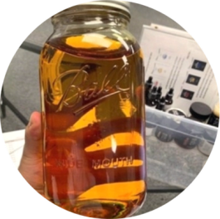
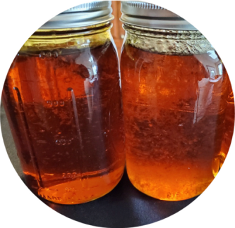
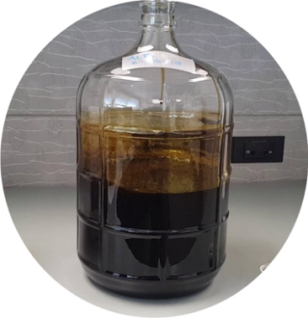
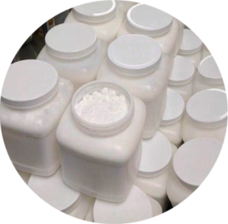
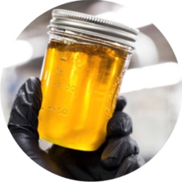
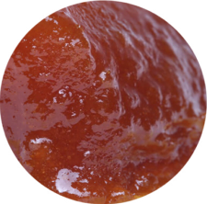
Product Line-up
Extracted Hemp Compounds Processed
To be an Oil, Powder or Water Soluble
Product Line
>80% CBD Broad Spectrum THC Free Non-detectable (ND) THC 0.00%
>80% CBD Full Spectrum, THC <0.03%
>80% CBD Full Spectrum, THC <0.03% With Minor Cannabinoids
>60% CBD, Crude Oil (not distilled), 0.3% CBD
>99.7% CBD Isolate, THC 0.0% (Powder)
CBG Isolate (Powder or Oil)
25% CBD Gold Oil, w/Medium Chain Triglyceride (MCT) such as Coconut Oil or Hemp seed oil
16% Water Soluble CBD Isolate (Powder)
Customization of above SKUs at additional cost
Organic versions of above SKUs at additional cost.
8
© 2020 HyperNovaTN, LLC

Slide 9
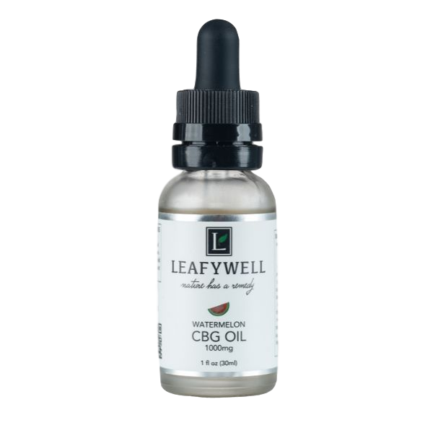
Product Descriptions
HyperNovaCBD Hemp Extracted Oils and Processed Product Line-up
Products are tested to be free of mold, metals and pesticides*
>80% CBD Broad Spectrum THC Free (Non-detectable 0.00%). Hemp CBD extract that contains all the naturally occurring terpenes , flavonoids gand cannabinoids but with the THC removed by highly specialized equipment is known as “Broad Spectrum CBD extract with non-detectable (0.00%) THC.” This is the preferred CBD product if a customer does not want any THC. The alternative (and at less cost) is CBD Isolate w/o THC, but it does not contain other cannabinoids or terpenes etc., just the CBD. However, the best effect from CBD is to have all the compounds present so the “entourage” effect is present.
>80% CBD Full Spectrum,THC <0.03%, with Minor Cannabinoids. Refined using molecular distillation technology containing on average >80% CBD while retaining terpenes and other beneficial compounds, without the chlorophyll and other heavier components that affect color and flavor.
>80% CBD Full Spectrum,THC <0.03%. Same as #2, w/less minor cannabinoids such as CBG, CBC etc.
4. >60% CBD, Crude Oil (not distilled), 0.3% THC. All CBD oil generally comes in three main forms: raw, decarboxylated, winterized and distilled. Crude oil is essentially a full spectrum product with <0.3% THC but has not gone through filtration processes. As such, crude oil will likely contain other compounds, like chlorophyll, terpenes, and microscopic plant material. Crude oil tends to be green in color because the plant material has not been filtered out. Typically used by OEMs for lower priced CBD products.
5. >99.7% CBD Isolate, THC 0.0% (Powder or Oil). CBD isolate is the purest form of CBD, produced by removing all other plant compounds found in hemp including terpenes, flavonoids, chlorophyll, and other cannabinoids. The highly refined CBD is then combined with a base like coconut or MCT oil for a final product that’s usually flavorless, nearly transparent, and extremely fluid. It is also available as a powder
6. CBG. Is much like an isolate as it only contains CBG. OEMs make products that become popular through use and medicinal effect. Other Isolates are CBC, CBN and CBC. All have their individual properties and cater to certain ailments. CBD and other cannabinoids can be added back in. Currently, the market for these isolates is just emerging and priced significantly above typically offered CBD products.
* As shown on the Certificate of Analysis
9
© 2020 HyperNovaTN, LLC

Slide 10
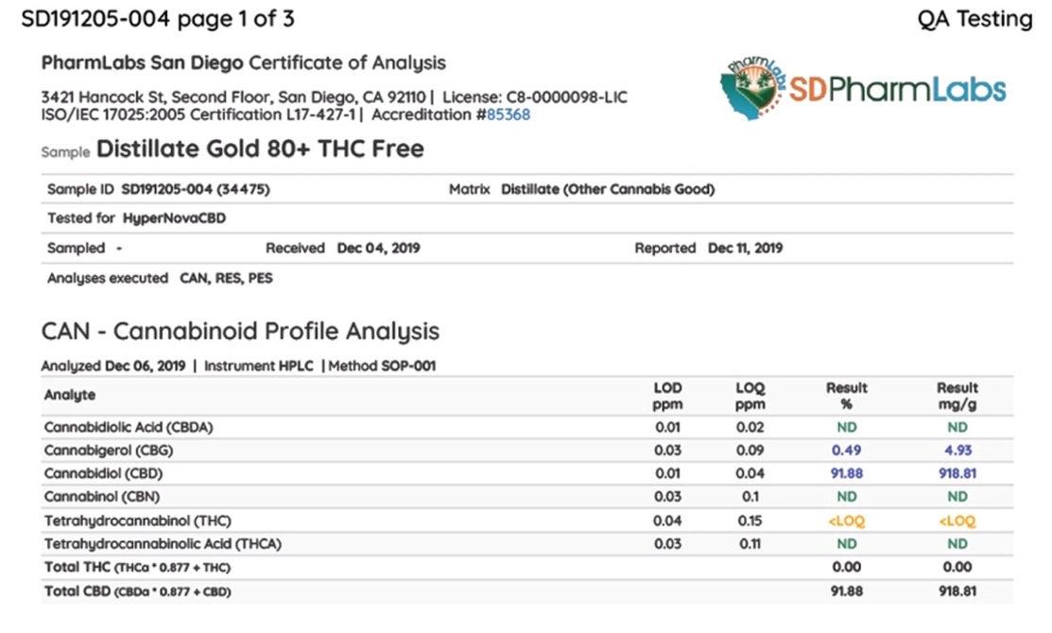
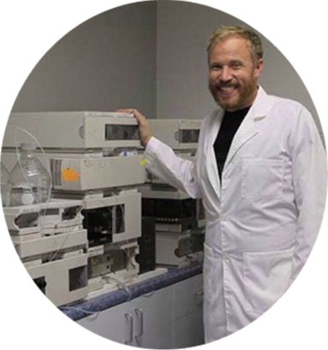
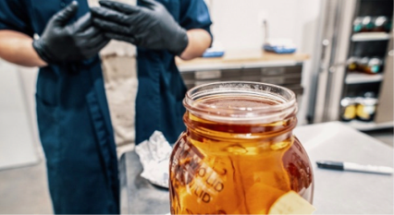
Certificate of Analysis
Reading the Lab Report (Certificate of Analysis)
The values for “Total CBD” and any “Minor” compounds determine the quality and price of a given batch of CBD oil
The report provides precise measurements of the key ingredients in a given CBD batch. A “batch” is a homogeneous amount of product extracted and processed from the same biomass harvest
*
*
Minor Cannabinoid Compounds
Minor Cannabinoid Compounds
Limit of Detection
*Note: Not shown, but part of a full panel test, are COA values for terpenes, flavonoids, lipids, heavy metals and pesticides.
Tetrahydrocannabinol (THC). Limit of Quantification
Limit of Quantification
THC is non-detectable (ND)
Total % of CBD
Total mg/g of CBD
(Above) Two distillations columns:: one for methanol removal the other for final biodiesel distillation
THC Total
10
© 2020 HyperNovaTN, LLC

Slide 11
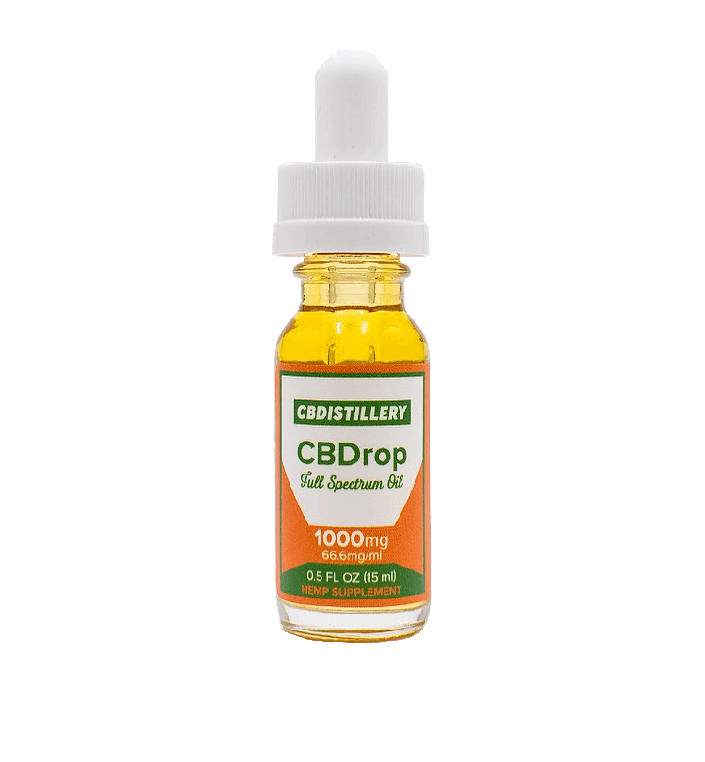
CBD Consumer Products
Typical Products Manufactured By the OEMs
These items are infused with CBD and listed by category. First list show several medicine administration types
Body Care
Intimate lube
Massage oil
Bath bombs & soaks
Face oil (Serum)
Lotion
Hand cream
Balm
Face mask
Eye serum
Body scrub
Face moisturizers
Beard balm
Deodorant
Smoking
Vaping
Flowers (Joints)
Pets
Pet Tincture
Pet Treats
Pet Topicals
Supplements
Tinctures (Drops)
InhalerN
Nasal Spray
Superfood Supplement
Capsules/softgels
Shatter (Isolates)
Edibles
Chocolates
Hard candies
Gummies
Lollipop
Mac & Cheese
Hummus
Jelly Beans
Honey
Cheese Puffs
Cereal
Mustard
Peanut Butter
Gum
Olive oil
Coconut oil
Popcorn
Beverages
Seltzer (Sparkling water)
Soda (or “Pop”, “Coke”
Coffee
Beer
Energy drink
Water
Tea
K-Cups
Cocktails
How To Read A CBD Product Label
Company name
Type of CBD oil
CBD total in Mg
CBD mg/ml
Bottle fluid capacity typically: 2 oz, 1 oz and 0.5 oz and expressed in ml
(Above) Typical chemistry lab with chromatography and other testing equipment to perform a complete ASTM test
ASTM = American Society for Testing and Materials
11
© 2020 HyperNovaTN, LLC

Slide 12
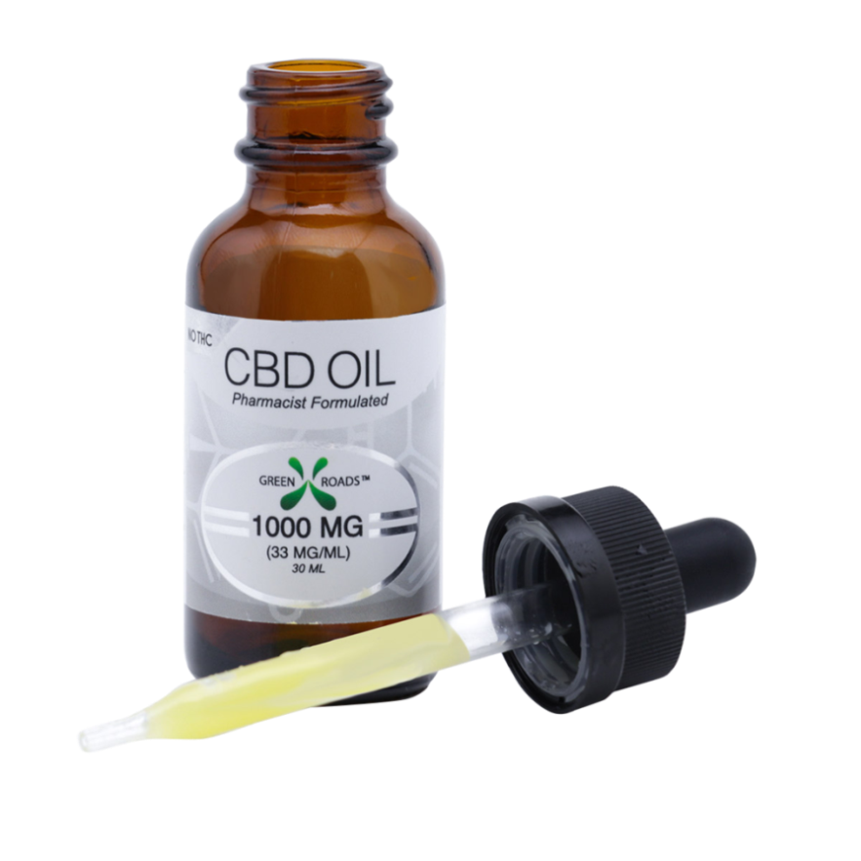
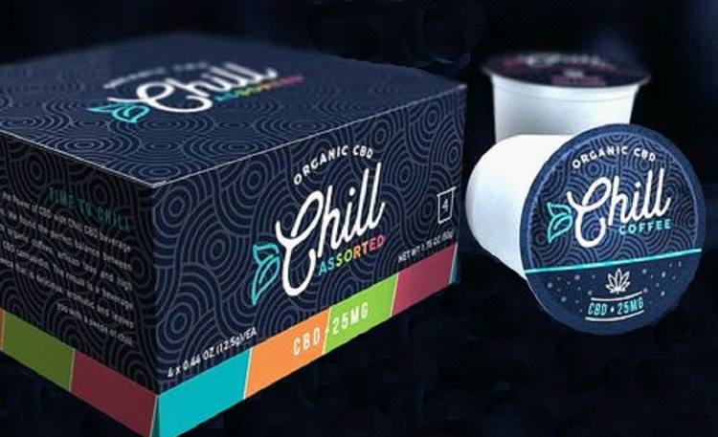
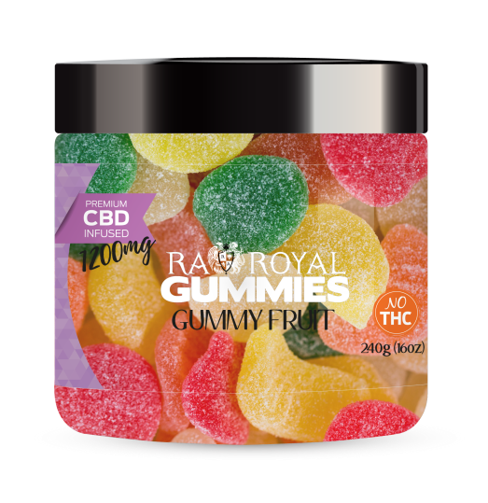
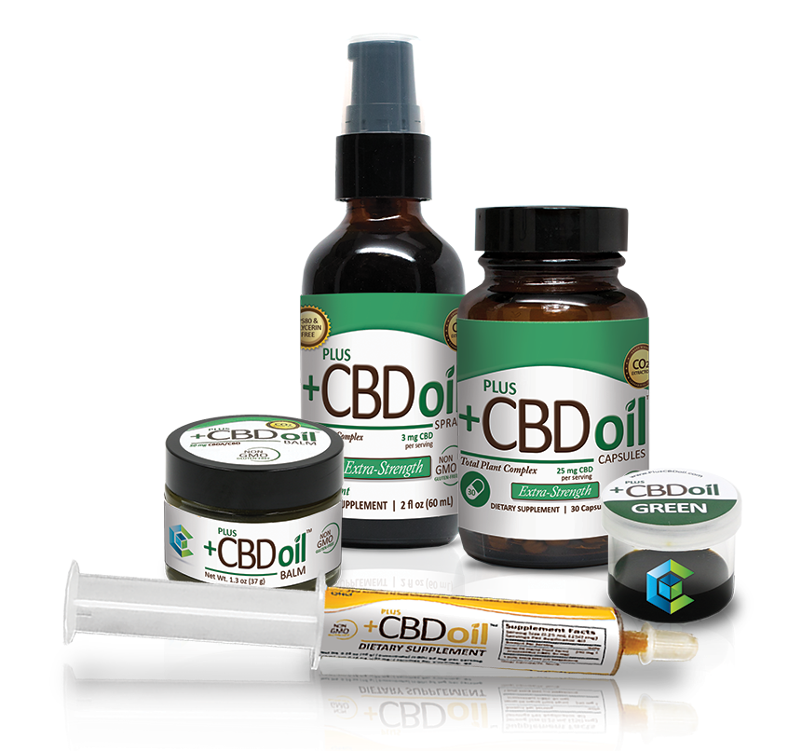
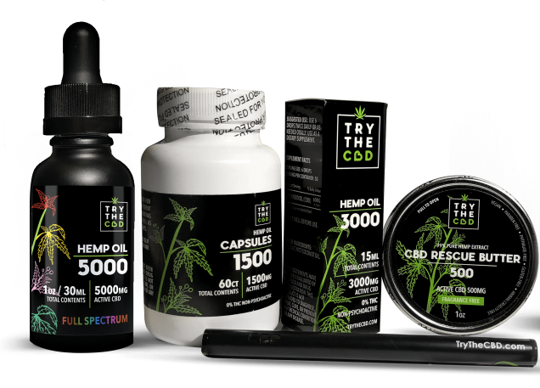
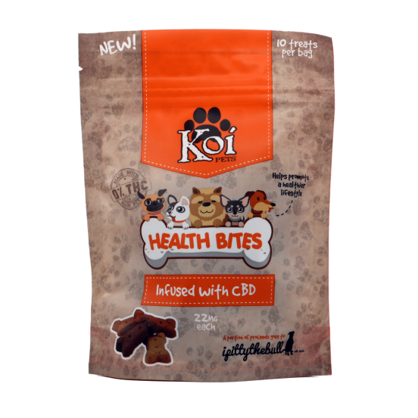
Typical CBD Packaging
Typical Products Manufactured By the OEMs
CBD items sold through mass market retailers and on-line . . .
12
© 2020 HyperNovaTN, LLC

Slide 13
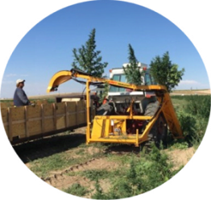
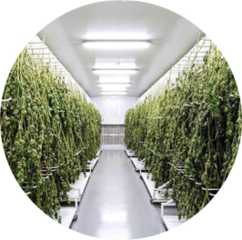
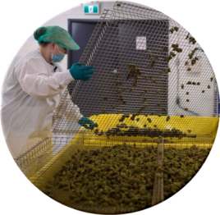
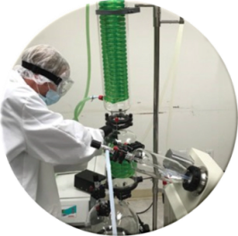
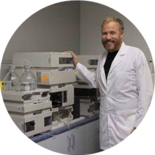
Extraction Methods
From Farmers to Extraction/Processing
Mechanical harvesting
of Hemp. Protects trichomes.
HyperNovaCBD’s Process Is Advanced and Unique
Extraction Methods and
Products Produced
Typically a crude extract requires further refinement in one form or another, be it winterization, filtration and even isolation. HyperNovaCBD employs a patented, unique design capable of producing a more refined product including new Hemp-based oil formulas and with less labor, plus other savings and capabilities.
THC Free: Most CBD in products is isolate CBD. Meaning, the CBD compound from the Hemp plant was removed leaving all other compounds (literally hundreds) behind. Not good.
HyperNovaCBD is expert in THC removal but process leaves behind every other compound in tact. It’s really just Full Spectrum CBD without the THC.
Compounds targeted: all available
Cannabinoids with resulting extract high or low in other Cannabinoids (called minors). Any of these can be isolated.
Ancillary requirements: legally licensed, compliant laboratory; ability to store ethanol alcohol. Other certifications.
The Most Common Extraction Methods
F A R M E R S
Dry-sieved then pressed hashish
Water extracted, dried, pressed hashish
Rosin, heat and pressure applied, squeezing out the resin
Liquid nitrogen extraction
CO₂ extraction
Ethanol alcohol extraction*
Hydrocarbon extraction
Distillation, wiped film, thin film or short path.
State-of-the-art precision drying process
Sorting prior to milling to ¼” square
The Most Common Products Produced
E X T R A C T I O N
Pressed resin glands (hashish)
Oil form sometimes referred to as RSO
Tincture
Shatter
Budder
Wax
HTFSE (high terpene full-spectrum extract)
HCFSE (high cannabinoid full spectrum extract)
Vape cartridges
CBD in crystalized form
THCA in crystalized form
Delta 8 in oil form.
Extraction, processing & refinement
Q. A. P.
Post- extraction 3rd party
testing
* Process used by HyperNovaCBD
13
© 2020 HyperNovaTN, LLC

Slide 14
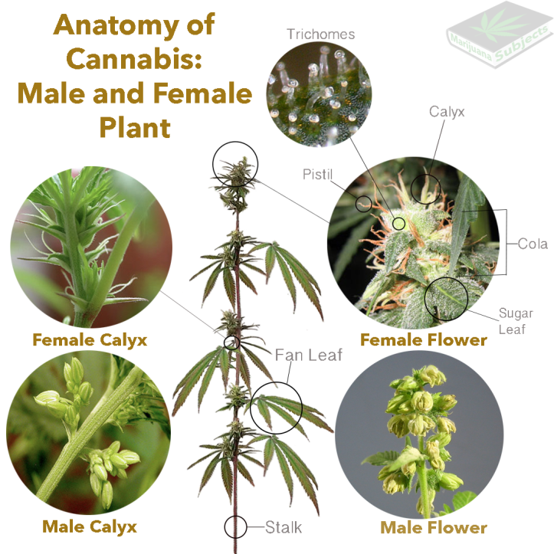
Hemp Plant Overview
The Cannabis Sativa Plant Produces Strains High or Low in CBD and THC
Differences
1. To differentiate strains of Cannabis Sativa, plants grown to be high in THC are called Marijuana, while plants with low levels (<1%) of THC are referred to as Hemp. 2. Visually, Marijuana is bushier with broader leaves, compared to hemp which is leaner with shinier leaves. 3. What really sets them apart is the differences in their chemical composition. More than 300 cannabinoid compounds are found in cannabis, but the amount of these cannabinoids differs dramatically between hemp and marijuana.
Plants Parts
1. Under USDA rules it is illegal to add any part of the hemp plant, its extracts or derivatives into foods. In some states where this is permissible with marijuana, authorities are turning a blind eye to its addition into drinks, gummies, candy/cookies and pet treats.
2. It is also illegal to recommend a medicinal use for any of the hemp extracts, compounds, seeds and fibers. The FDA (Federal Drug Admin.) scans the internet routinely and issues stern warnings for violators.
Read More: https://www.fool.com/investing/2019/02/09/hemp-vs-marijuana-whats-the-difference.aspx
14
© 2020 HyperNovaTN, LLC

Slide 15
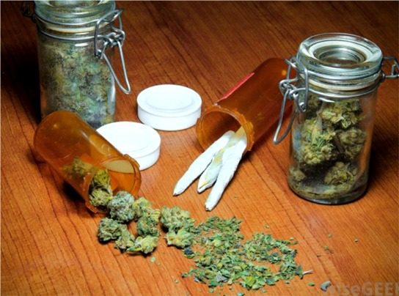
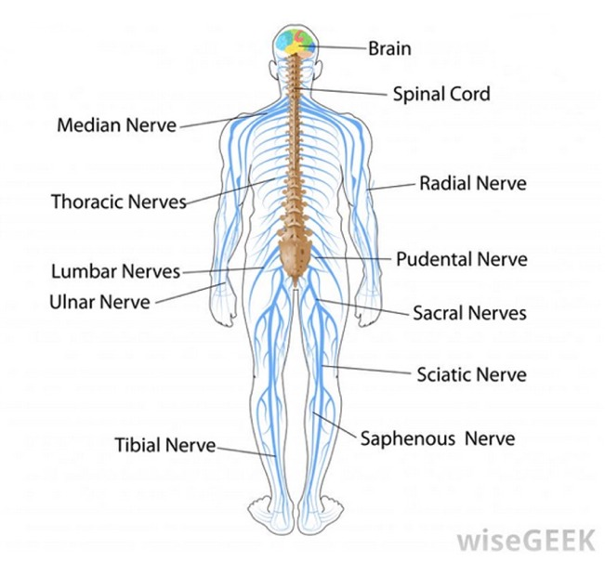
Hemp Neuro Science
Endocannabinoid System; Entourage Effect; Terpenes, Flavonoids and Other Compounds
The Endocannabinoid System (ECS)
The chemical makeup of endocannabinoids are closely mimicked by cannabis.
ECS is a set of signaling molecules in the central and peripheral nervous system that helps regulate processes of the body such as appetite, pain, mood, and memory. This is where CBD reacts with a user.
No two person’s endocannabinoid system is the same and therefore people will encounter varying effects when using cannabinoids, CBD being one of the most prominent. So in effect, not empirical, and presumably why doctors do not yet prescribe until FDA direction.
Terpenes & Flavonoids
Alongside Cannabinoids in the Hemp plant are Terpenes, these give color, whereas the Flavonoids provide smell to the Hemp oil. CBD high in these compounds typically cost more.
The central nervous system, which consists of the brain and spinal cord, receives and transmits signals to the nerves in the peripheral nervous system, which is composed of the nerves in the organs and muscles of the body.
Entourage Effect
This effect provides the entire experience of the plant’s medicinal capabilities with about 400 compounds present. CBD Isolate only offers the value of CBD alone.
Receptors in the endocannabinoid system regulate the body's perception of pain.
Read More: https://www.leafly.com/news/cannabis-101/list-major-cannabinoids-cannabis-effects
https://www.whatiscbd.com/role-of-the-endocannabinoid-system-in-mood-homeostasis/
15
© 2020 HyperNovaTN, LLC

Slide 16
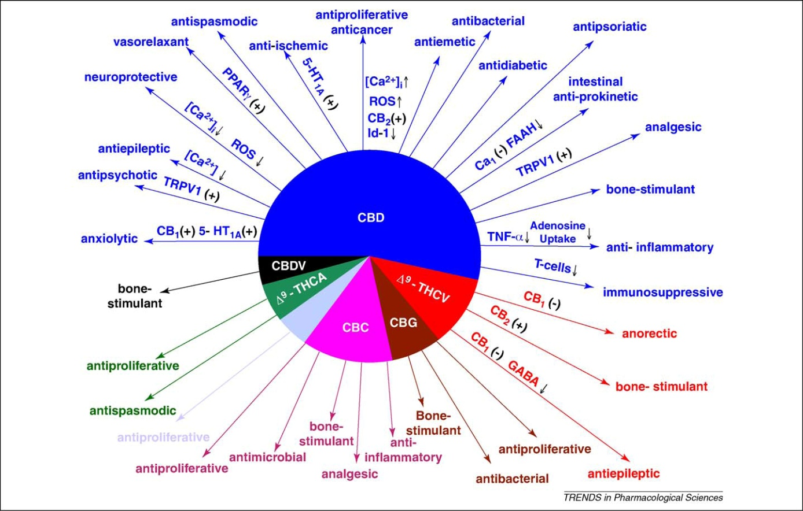
Hemp Plant Cannabinoids
CBD Oil is More Effective Than Anything Else at Reversing Literally 100’s of Ailments, Including:
Hemp Contains About 400 Cannabinoids
Most Popular Cannabinoid Uses to Date
CBD has overtaken THC as the most popular cannabinoid found in the Cannabis Sativa plant. CBD is a medicinal health supplement with <0.3% THC. On its own THC is for recreation and provides a euphoric experience with typically 5% to 35% THC. By law, the Company is not allowed to do business in THC above 0.3% (i.e. 1/3rd of 1%).
Joint Pain
Arthritis
PTSD
Autoimmune Disease
Diabetes
Multiple Forms Of Cancer
High Blood Pressure
Prostate Issues
Alzheimer’s
Depression, Bipolar Disorder
Age Cognitive Decline
Migraines And Headaches
Cardiovascular Issues
Crohn’s And Colitis
Endocrine Disorders
Inflammation
Nausea
Multiple Sclerosis
Neuropathic pain
Neurodegeneration
Parkinson’s
Rheumatism
Chronic stress and fatigue
Spinal cord injury
Stroke
Obesity
Skin conditions, psoriasis and adult acne
Schizophrenia
And much, much more…
Read More: https://www.leafly.com/news/cannabis-101/list-major-cannabinoids-cannabis-effects
16
© 2020 HyperNovaTN, LLC

Slide 17
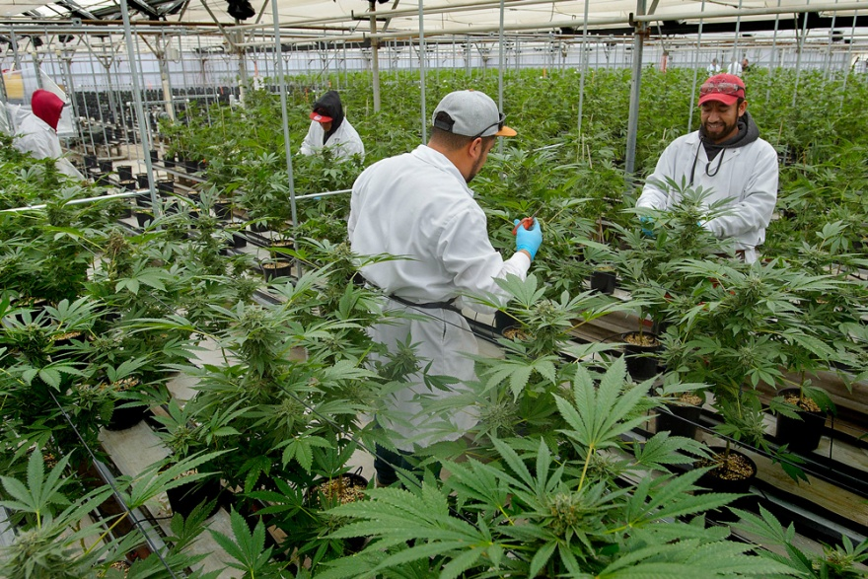
Legal
Rules and Protocols for Growing, Processing and Marketing Hemp Extracts and Fibers
2018 U.S. Farm Bill
Under the U.S. Farm Bill 2018, and beginning January 1, 2019, the hemp plant, (called Cannabis Sativa) became legal but only
providing its THC level (Tetrahydrocannabis) is below 0.3%. Hemp can now be grown, harvested, sold and transported across state lines – including importing and exporting and treated just as any other agricultural commodity for insurance, banking etc.).
State Regulations
Under the 2018 U.S. Farm Bill, it is required that each State set up its own program and have it approved by the USDA (U.S. Dept. of Agriculture). Growers must have Federal Tax I.D., a State license and Resale Number. They are required to report annually their acreage and other activity details periodically to the USDA.
Protocols
1. Under USDA rules it is illegal to add any part of the hemp plant, its extracts or derivatives into foods. In some states where this is permissible with marijuana, authorities are turning a blind eye to its addition into drinks, gummies, candy/cookies and pet treats.
2. It is also illegal to recommend a medicinal use for any of the hemp extracts, compounds, seeds and fibers. The FDA (Federal Drug Admin.) scans the internet routinely and issues stern warnings for violators.
Workers trimming flowers in a light and temperature controlled indoor/greenhouse environment
Read More: https://www.farmers.gov/manage/hemp
17
© 2020 HyperNovaTN, LLC

Slide 18
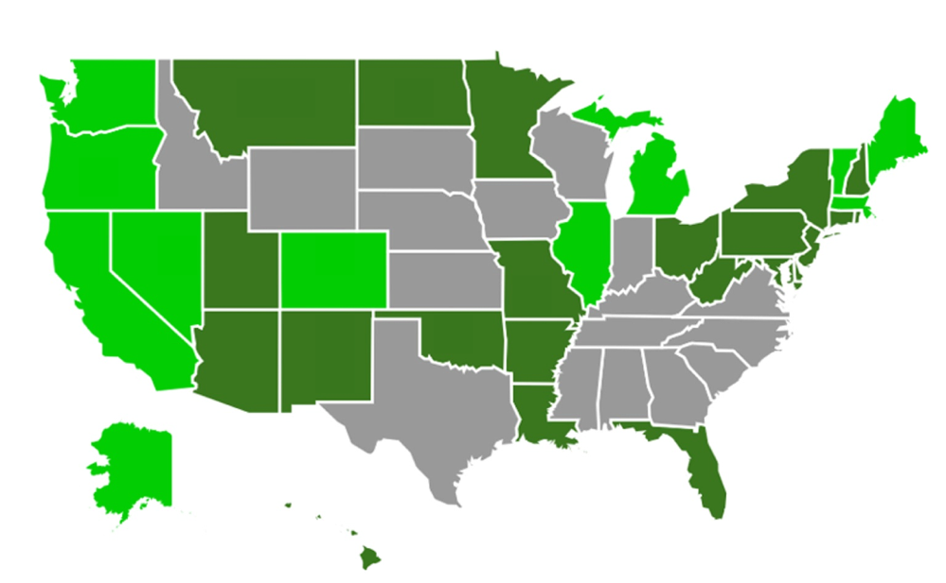
Legal, States
States Where CBD is Legal or In-Process. States Status With MJ
CBD Legend
NO = CBD is not legal to grow and sell
IP = State is in the process of developing a program for approval by the federal government (USDA) as 1/20
All other states (without a NO or IP designation) have already filed with the USDA for program approval and are currently active in the business.
Regardless of a state’s status, it is legal to transprot Hemp and CBD products through a state.
IP
NO
NO
NO
IP
NO
NO
IP
D.C. NO
NO
IP
IP
NO
IP
NO
NO
For ANY state to be legal, it must get their Hemp Program approval by
the USDA
IP
Medical or recreational marijuana illegal
Medical marijuana legal
Recreational and medical marijuana legal
This chart will be updated as states change their CBD, medical and recreational marijuana laws
18
© 2020 HyperNovaTN, LLC

Slide 19
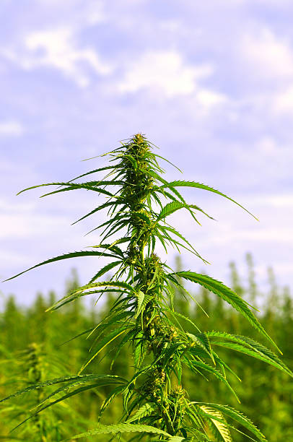
Licensing & Certifications 1
As a One Year Old Industry It Is largely Self-Regulated, So Being Credentialed Important
1. Proof of a real manufacturing facility
To date, the CBD industry has been largely unregulated. This means that oil can be extracted pretty much anywhere, and no one would know the difference. When researching various CBD manufacturers, make sure the
product they’re offering is made in a legit manufacturing facility rather than in someone’s garage or storage shed.
2. Information on where the hemp comes from
Where does the manufacturer source the hemp from which their CBD is made? Is it grown sustainably and in accordance with the highest cultivation standard? Is it grown in the U.S. or is it sourced from overseas? The top CBD manufacturers will let you know exactly where the hemp that is used to create their products comes from.
3. Knowledge of the entire process from seed to sale Have you ever stopped to think of the entire process of making CBD oil? From seed to sale, there are several things involved. “Seed to sale” is a system that can be used to track the entire process including cultivation, harvest, extraction, production, distribution and sales. These tracking systems often contain a combin- ation written records and software in a single database that can be used by culti- vators, processors, manufacturers, transporters and others involved in the process that provides a thorough history of the product.
Continued . . .
19
© 2020 HyperNovaTN, LLC

Slide 20
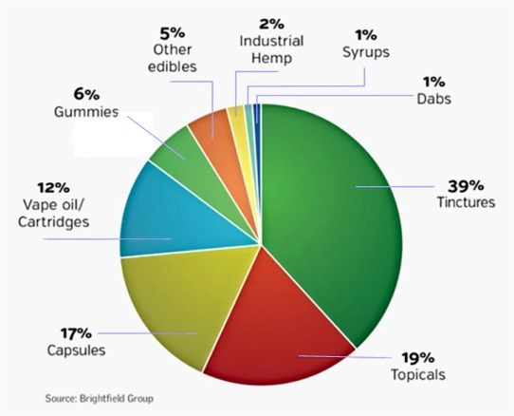
Licensing & Certifications 2
. . . from page 19
4. Appropriate regulatory licenses and proper
manufacturing certifications While CBD has been largely unregulated up until now,
there are certain regulatory licenses and proper manufacturing
certifications that the best CBD manufacturers will carry. Regulatory
licenses will vary from state to state and manufacturers should be
clear about the regulatory licenses they carry. ISO is also something
to keep an eye out for, which is a quality management system that
helps organizations ensure that they meet the needs of customers
and stakeholders while meeting statutory and regulatory requirem-
ents related to CBD. Some manufacturing certifications top CBD
manufacturers will hold include Good Manufacturing Process (GMP)
certification and Governance and Professional Practice certification.
5. Certificates of Analysis each product batch
A certificate of analysis (COA) is a laboratory report regarding the contents of a product. In the case of CBD, a COA will include
cannabinoid content and other tested compounds, such as pesticides, mold and heavy metals. COAs ensure the customer knows exactly what is in the product they’re purchasing. Not only does this create transparency, but also ensures that the product contains exactly what it claims. A 2017 study found that almost 70% of CBD products sold online aren’t labeled correctly, having either considerably less or more CBD than advertised. CBD manufacturers should offer the most recent COAs of the products they provide.
Breakdown of Hemp-derived CBD products in the U.S. - 2018
20
© 2020 HyperNovaTN, LLC

Slide 21
Sales Presentation 1
Presentation Concept to Prospects
1. Warm-up
It’s really important to chat with your prospect for a couple of minutes before diving into the presentation. The conversation should be about them as much as possible. Think family, recreation, their business . . . anything but the reason you are there (3 minutes)
TIP #1 It’s very important to NOT dig too deep. Be casual, as if you don’t care. You are there to educate them, NOT SELL. That comes much later or on another day.
2. Discovery
Ease carefully into asking the right questions (think Columbo on this!):
Qualification. Am I speaking with the right person? Is he or she the decision maker?
Right fit. Are you sure you are there to talk about CBD? Often there is a disconnect on this. Rather, you might clear at appointment confirmation.
Knowledge: Does the prospect know anything about CBD?
Need: Are they currently involved with CBD? What are their concerns?
Get prospect talking: Find out what their level of interest is and are they budgeting anything this year or next. (10 minutes)
TIP #2 Explain this quickly and briefly covering the different subject matter sections only
3. Presentation
You are ready now to start presentation. But first tell prospect what you are going to do.
(i) Preview. “Ms Purchasing Agent, I’m going to give you a brief summary of CBD: (a) The date we are able to provide you CBD extracts (some not available now) (b) Where the hemp was grown (state only)
( c) How the hemp plant is cultivated, harvested and dried (d) How the CBD extracted (oil) is taken from the hemp plant
(e) How we take out the THC from the extract (f) A little about the background and experience of our company (g) At any time feel free to jump in with any questions or comments
(h) If you are ready to buy today I will give you a “today quote;” if not, then I will provide a figure good for 30 days and be on my way.
TIP #3 If they want a “today quote” you have to ask more about volume usage and over what time period. Push for a one year contract with price adjustments each quarter. (More on this later in presentation)
21
© 2020 HyperNovaTN, LLC

Slide 22
Sales Presentation 2
Typical Presentation to Prospects
3. Presentation (cont.)
(ii) Presentation. (a) First let me go over what CBD is. It’s one of about 400 compounds in the hemp plant. It is one of the well-know ones for medicinal use. CBD stands for cannabidiol. Another is THC, and that stands for Tetrahydrocannabinol. This compound is the one that gets you high/intoxicated. The hemp we use is a strain very high in CBD, however, the THC is very low, and by law it must not be over 0.3% by weight (that’s 1/3rd of 1%). It’s impossible to get high on that amount of THC. (b) Some people want zero THC in their CBD. The reason is they either just don’t want any THC or they work where drug tests are routinely given and the THC will show in the analysis as with CBD use a tiny amount of THC will build up in ones body over time
(c) We provide an option of CBD without any THC. Using very sophisticated equipment, we actually take out any THC and leave all the remaining several hundred cannabinoids in the extracted oil.
(d) Another way to take out the THC. Many companies don’t have the means to take out the THC, so they simply take out the CBD. Isolate it. Now while this gives you a THC free product you end up without the balance of the hemp’s other compounds such as CBG, CBC, CBN and a few hundred more, the terpenes, flavonoids and other compounds that together provide you the full benefit of all the compounds.
(e) Harvesting and drying the hemp is critical as with too much handling and moving around it damages the plant including the trichomes, the sugary looking substance on many of the leaves that form the colas (flowers of the plant). And the drying/curing process must be done slowly and not in a very hot or cold environment either. (f) A little about our background. We started 16 years ago using agricultural oils to make biodiesel, and this experience is now being carried over to take the oil from hemp and process it as per what our customer requires. There are many other compounds in the hemp plant that can be extracted and used on their own or combined with others.
TIP #4
This is a partial draft of a typical presentation and to be completed
22
© 2020 HyperNovaTN, LLC

Slide 23
Price List
Payment Terms
1. Purchase Order
Current Pricing for CBD Extracts and Isolates
In writing on company letterhead and signed by CFO or Authorized person.
SKU Item | 1 to 10 | 11 to 49 | 50 to 299 | 300+
2. Agreement
>80% CBD Broad Spectrum. Non-detectable THC (0.00%) | $6,000 | $5,742 | $4,842 | $4,242
>80% CBD Full Spectrum, THC <0.03%, w/Majors | 4,200 | 3,767 | 3,067 | 2,667
>80% CBD Full Spectrum, THC <0.03%, w/Majors | 3,700 | 4,373 | 3,673 | 3,273
>60% CBD, Crude Oil (not distilled), 0.3% CBD | 3,400 | 2,797 | 2,097 | 1,697
>99.7% CBD Isolate, THC 0.0% (Powder or Oil). | 4,000 | 3,524 | 2,824 | 2,424
25% CBD Gold Oil, /Medium Chain Triglyceride (MCT) such as Coconut Oil or Hemp seed oil | 2,000 | 2,312 | 1,612 | 1,212
16% Water Soluble CBD Isolate (Powder) | 5,600 | 4,252 | 3,552 | 3,152
Price is based on an annual contract. Includes delivery.
In writing on company letterhead and signed by CFO or Authorized person.
Customer designates Majors preferred. Price is based on annual contract
3. Price
Prices are negotiable. No changes in price after closing allowed.
Allow up to three business days for Agreement delivery. A proforma will be provided at time of Purchase.
Lower CBD values will decrease price accordingly. Annual contract required.
Customer to designate exact carrier oil preferred. Price higher for some oils. Annual contract required
4. Delivery
As per P.O.
5. Payment
Terms depending on order amount and experience with customer. Terms range from payment in advance to escrow and 10-30 day net terms.
No annual contract required for all other price columns. No shipping included
Prices good for 30 days from quote date. Phone orders require simultaneous email confirmation
(Above) Two distillations columns:: one for methanol removal the other for final biodiesel distillation
23
© 2020 HyperNovaTN, LLC

Slide 24
Glossary of Terms B C D E F H I M P S T V W
Broad Spectrum A type of hemp oil that contains the same full list of compounds as full-spectrum hemp oil, except for THC. Broad-spectrum CBD oil has had the trace amounts of THC that are found in full-spectrum CBD oil removed.
Cannabidiol
The non-intoxicating phytocannabinoid in cannabis that is widely used to promote balance and wellness. Cannabidiol, more widely known as CBD, is most abundant in hemp but it also found in marijuana.
Cannabinoid
A class of active chemical compounds that act on cannabinoid receptors located in our cells as part of the endocannabinoid system to alter the release of neurotransmitters in the brain. Canabinoids can be either endocannabinoids, which means they’re synthesized by the body, or phytocannabinoids, which means they’re found in plants like hemp.
Cannabinoid Receptors A class of cell membrane receptors under the G-protein-coupled receptor superfamily. Cannabinoid receptors are a crucial component of the body’s native endocannabinoid system. Found in mammals like humans and pets, they work closely with chemical messengers called cannabinoids. When cannabinoid receptors and cannabinoids come together, they trigger a series of reactions designed to bring functions back into balance. The two most widely understand cannabinoid receptors are the cannabinoid 1 (CB1) and the cannabinoid 2 (CB2) receptor.
Cannabis A genus of flowering plants in the family Cannabaceae that is used to produce fiber, food, and wellness products, or to consume for intoxicating purposes. Hemp and marijuana are both cannabis plants.
CBD The acronym for cannabidiol, a phytocannabinoid found in cannabis that is widely used as a wellness product.
CBD Capsules Ingestible capsules that contain either full-spectrum CBD oil or CBD isolate. CBD capsules are often preferred by those seeking the most convenient way to consume CBD.
24
© 2020 HyperNovaTN, LLC

Slide 25
Glossary of Terms
B C D E F H I M P S T V W
CBD Concentrate A natural botanical extract sourced straight from the hemp plant. CBD oil concentrate has a thick, viscous consistency and can be swallowed or absorbed under the tongue. CBD Edibles Ingestible food-type products infused with full-spectrum CBD oil or CBD isolate.
CBD Edibles Ingestible food-type products infused with full-spectrum CBD oil or CBD isolate.
CBD Isolate A pure crystalline powder containing only the CBD chemical compound. CBD isolate is CBD oil that has been refined down to a highly concentrated powder containing 99 percent CBD through a proprietary filtration process. This process eliminates hemp oil’s plant material, waxes, chlorophyll, and more. CBD isolate is the most concentrated CBD product available.
CBD Oil A natural, non-intoxicating extract of the hemp plant. CBD oil, also commonly referred to as CBD hemp oil, can be consumed on its own or infused into a variety of products to promote.
wellness.
CBD Tincture A liquid extract containing a mix of full-spectrum CBD oil or CBD isolate and vegetable glycerin, ethanol, or medium chain triglyceride (MCT) oil. A CBD tincture is often preferred by consumers who prefer their CBD product in liquid form.
CBD Topical Balms, salves, lotions, oils, hair care products, and other beauty products that have been infused with
CBD or CBD oil. CBD topical products are applied directly to the skin and hair.
25
© 2020 HyperNovaTN, LLC

Slide 26
Glossary of Terms
B C D E F H I M P S T V W
Clinical Endocannabinoid Deficiency Syndrome (CECD A theory that aims to explain why in some cases the endocannabinoid system is unable to properly keep the body balanced. Introduced by researchers EB Russo in 2001, clinical endocannabinoid deficiency syndrome, or CECD, proposes that a deficiency in cannabinoids leads to a dysfunction in the endocannabinoid system, leading to health issues.
Concentration A term used to describe the potency of a cannabidiol (CBD) product. For example, a CBD tincture bottle containing a total of 200 mg of CBD would have a CBD concentration of 200 mg. CBD concentration generally varies by type of products, with CBD oil concentrate and CBD isolate often having a higher concentration, and CBD tinctures and CBD edibles having a lower concentration.
Controlled Substances Act The statute establishing federal U.S. drug policy under which certain substances are regulated. Signed into law in 1970, the Controlled Substances Act (CSA) classifies marijuana as a Schedule I substance, the most restrictive category. Hemp was removed from the list of controlled substances with the passage of the 2018 Farm Bill.
CBD Vape Oil A CBD-infused liquid designed to be paired with a personal device called a vaporizer to produce a pure CBD filled vapor that can be inhaled. Vaping CBD oil is an extremely efficient way to absorb CBD through the lunges.
Decarboxylation The process of heating cannabis to activate the compounds within the plant. Raw cannabis contains cannabinoid acids, which are inactive cannabinoids that have an extra carboxyl ring attached to their molecular chain. Decarboxylation converts the molecular structure of these cannabinoid acids by removing a carboxyl group. This activates the cannabinoids so that they can freely and directly interact with the endocannabinoid system’s receptors in the brain and throughout the body. For example, decarboxylation converts cannabidiolic acid (CBDA) to cannabidiol (CBD).
26
© 2020 HyperNovaTN, LLC

Slide 27
Glossary of Terms
B C D E F H I M P S T V W
Endocannabinoid A class of naturally occurring active chemical compounds made by the human body. Endocannabinoids act on cannabinoid receptors located in our cells as part of the endocannabinoid system to alter the release of neurotransmitters in the brain. The two primary endocannabinoids include Anandamide and 2-arachidonoylglycerol.
Endocannabinoid System A complex signaling network responsible for keeping the body balanced and functioning at its peak. Also known as the ECS, the endocannabinoid system responds to external influences to maintain homeostasis. It is made up of neurotransmitters and cannabinoid receptors located in the brain and throughout the body. It is through the endocannabinoid system that the naturally occurring cannabinoids interact with our bodies to promote health and wellness.
Entourage Effect A theory used to describe how all of the compounds found in cannabis work together synergistically with the body. Introduced in 1998 by renowned researchers Raphael Mechoulam and S. Ben-Shabat, the entourage effect theory suggests that the natural benefits of cannabis are enhanced when a product contains the full spectrum of cannabinoids, terpenes, and other natural compounds that are naturally found within the plant.
Extraction The separation process used to separate a desired substance, such as to pull oils from plants. Extraction methods may include CO2 extraction, steam distillation, solvent extraction, and cold press extraction.
Farm Bill Also known as the Agricultural Improvement Act, the Farm Bill is a comprehensive omnibus bill renewed every 5 years to shape food, agriculture and more. The 2018 Farm Bill contained provisions that clarified the legality of hemp and hemp-derived products like CBD oil in the United States. The provision amended the federal list of controlled substances with regard to hemp and reclassified the plant as an agricultural commodity, allowing U.S. farmers to grow, process, and sell the plant commercially. It also legalized hemp nationwide for any use.
Flavonoids A naturally occurring group of phytonutrients responsible for the hemp plant’s vivid green color pigments. Roughly 20 flavonoids are thought to be in cannabis, and only a few are exclusive.
27
© 2020 HyperNovaTN, LLC

Slide 28
Glossary of Terms
B C D E F H I M P S T V W
Flavonoids A naturally occurring group of phytonutrients responsible for the hemp plant’s vivid green color pigments. Roughly 20 flavonoids are thought to be in cannabis, and only a few are exclusive.
Flavonoids protect cannabis plants by filtering out UV rays and preventing diseases, pests, and fungi. Besides contributing to the color and overall sensory experience of cannabis, flavonoids are also active compounds that naturally promote wellbeing.
Full Spectrum Hemp Oil A term used to describe the unadulterated extract of the hemp plant, including all of its active compounds. Full-spectrum hemp oil contains the entirety of compounds naturally found in the hemp plant, including CBD and a list of other trace cannabinoids, flavonoids, terpenes, and dietary nutrients like proteins, fiber, and fatty acids. Full-spectrum CBD oil is also a natural source of many vitamins and minerals, including B complex vitamins, vitamin C, vitamin E, calcium, and magnesium.
Hemp The non-intoxicating member of the Cannabis sativa L. plant species. Grown all over the world, hemp is the food and fiber variety of the cannabis plant. It naturally contains no more than 0.3% tetrahydrocannabinol (THC), the intoxicating phytocannabinoid that elicits euphoric effects. Unlike its cousin marijuana, hemp is legal at the federal level in the U.S.
Hemp Oil Often used interchangeably with CBD oil. Hemp oil describes any and all oil that is extracted from any part of hemp, including the plant’s stalks, flowers, and seeds. That includes CBD oil, as well as hemp seed oil.
Homeostasis A term used to describe the dynamic stability of your internal environment. The endocannabinoid system is tasked with maintaining homeostasis in the body and in its systems.
Industrial Hemp A term used to refer to hemp cultivars grown for their stalks and seeds to produce thousands of products, including food, paper, rope, textile clothing, naturally biodegradable plastic, hemp body care products, and cannabidiol (CBD) hemp oil products, to name a few.
28
© 2020 HyperNovaTN, LLC

Slide 29
Glossary of Terms
B C D E F H I M P S T V W
Isolate The purest form of CBD. Isolate, or CBD isolate, is made from all-natural hemp oil that undergoes a purification process to eliminate all other compounds found in the plant, including terpenes, flavonoids, plant parts, other trace cannabinoids, and more. Isolate comes in the form of a fine white powder made up of 99% pure CBD.
Marijuana The intoxicating member of the Cannabis sativa L. plant species. Marijuana is grown to encourage the production of flowers that are high in tetrahydrocannabinol (THC), the phytocannabinoid responsible for euphoric effects. Marijuana remains illegal at the U.S. federal level.
Phytocannabinoid A term used to describe cannabinoids that naturally occur in plants, including cannabis. There are more than 110 phytocannabinoids identified so far in the cannabis plant. Two of the most widely recognized are cannabidiol (CBD) and tetrahydrocannabinol (THC).
Phytocannabinoids share a similar molecular structure to endocannabinoids, or cannabinoids that are synthesized by the body. This allows phytocannabinoids to interact with cannabinoid receptors to influence the behavior of the body’s endocannabinoid system.
Phytochemical Used to describe the entire spectrum of chemical compounds found in plants. In cannabis, phytochemicals include cannabinoids, flavonoids, terpenes, as well as essential vitamins and minerals, fatty acids, fiber, protein, and chlorophyll.
Psychoactive A term used to describe a substance that affects the mind. CBD is often mischaracterized in sources as ‘non-psychoactive,’ when in reality CBD has demonstrated influence on one of the body’s major native regulatory networks, the endocannabinoid system. CBD’s interaction with the endocannabinoid system alters the release of neurotransmitters in the brain and elsewhere, naturally promoting balance in the body and its functions. Rather than CBD being labeled as non-psychoactive, a more accurate description would be that CBD is ‘non-intoxicating,’ because the compound does not elicit any euphoric effects.
29
© 2020 HyperNovaTN, LLC

Slide 30
Glossary of Terms
B C D E F H I M P S T V W
Supercritical CO2 An extraction process that separates one component from another using fluid CO2 as a solvent. This process is used to remove an unwanted component, such as caffeine from decaffeinated coffee. Supercritical CO2 can also be used to collect specific components, like a plant’s essential oils, terpenes, and other valuable components. Liquid CO2 is an effective and safe solvent for creating CBD oil extract.
Tetrahydrocannabinol The phytocannabinoid in cannabis that is responsible for producing intoxicating effects. Tetrahydrocannabinol, more widely known as THC, is only found in trace levels in hemp. It is most plentiful in marijuana.
Terpenes Essential oils in cannabis that give the plants their distinct smell and taste. More than 200 terpenes have been identified in cannabis so far, and evidence shows that they also interact with the body’s endocannabinoid system to support health.
THC The acronym for tetrahydrocannabinol, a well-known phytocannabinoid found in cannabis.
Vaporizer
A personal device designed to vaporizer substances for inhalation. Vaporizers can be used with CBD vape oil to produce CBD-filled clouds of inhalable vapor.
Winterization
To avoid CBD vape oils that have cuticle waxes, you can look for products that have undergone a process called winterization. Winterization is a technique that involves removing all (or at least a portion of) the waxes, fatty acids, and lipids. This will allow for a higher melting point. If you’re unsure whether a specific CBD vape juice has undergone winterization, call the company and ask them. If they can’t tell you, then steer clear and look for another brand.
*
30
© 2020 HyperNovaTN, LLC

Slide 31
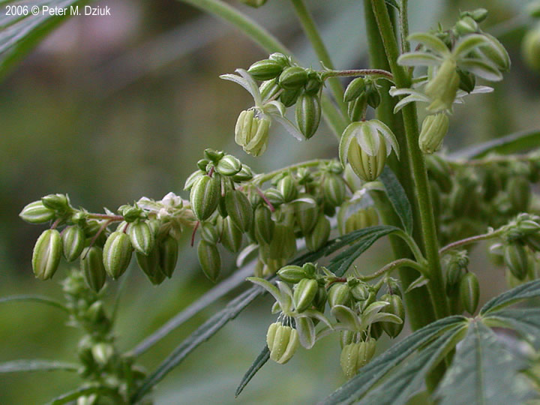
For More Information about HyperNovaCBD Contact:
Ian M. Lawson
(619) 630-6382
ilawson@HyperNovaCBD.com
4738 Gateway Circle, #216
Kettering, OH 45440
www.HyperNovaCBD.com

